Slide 1
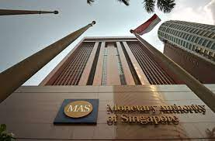
Lecture 2: Financial system, financial markets and instruments
HE Tai-Sen
FINANCIAL ECONOMICS

Slide 2
Financial System, Financial Markets and Instruments
Outline
Financial System (1.1, 1.2, 1.6)
Financial asset
Financial system
Asset Classes and Financial Instruments (2.1-2.5)

Slide 3
Financial System, Financial Markets and Instruments
Financial System
What is a financial asset?
Real assets (land, buildings, machines) produce goods and services while financials assets are merely sheets of paper.
Financial assets represent claims to the income generated by real assets.
financial instrument=financial asset=financial claim

Slide 4

Financial System, Financial Markets and Instruments
Financial System
Example: real asset (Hen) v.s. financial asset (Stock)
EGG farm’s Balance Sheet
Asset
Hen 1000
Debt
Bank Loan 400
What the company OWEs
What the company OWNs
Equity
Common Stock 600
Separate Entity Assumption

Slide 5
Financial System, Financial Markets and Instruments
Financial System
Different types of financial assets:
1. Fixed income (Debt) securities:
Definition: debt securities promise either a stream of income or a stream of income determined by a specified formula. Example: government bonds.
2. Equity securities:
Definition: equity represents an ownership share. Equity holders are not promised any particular payment. They receive any dividends the firm may pay. Example: common stocks.
3. Derivatives:
Definition: financial assets whose values derive from the values of other assets. Example: futures, options.

Slide 6
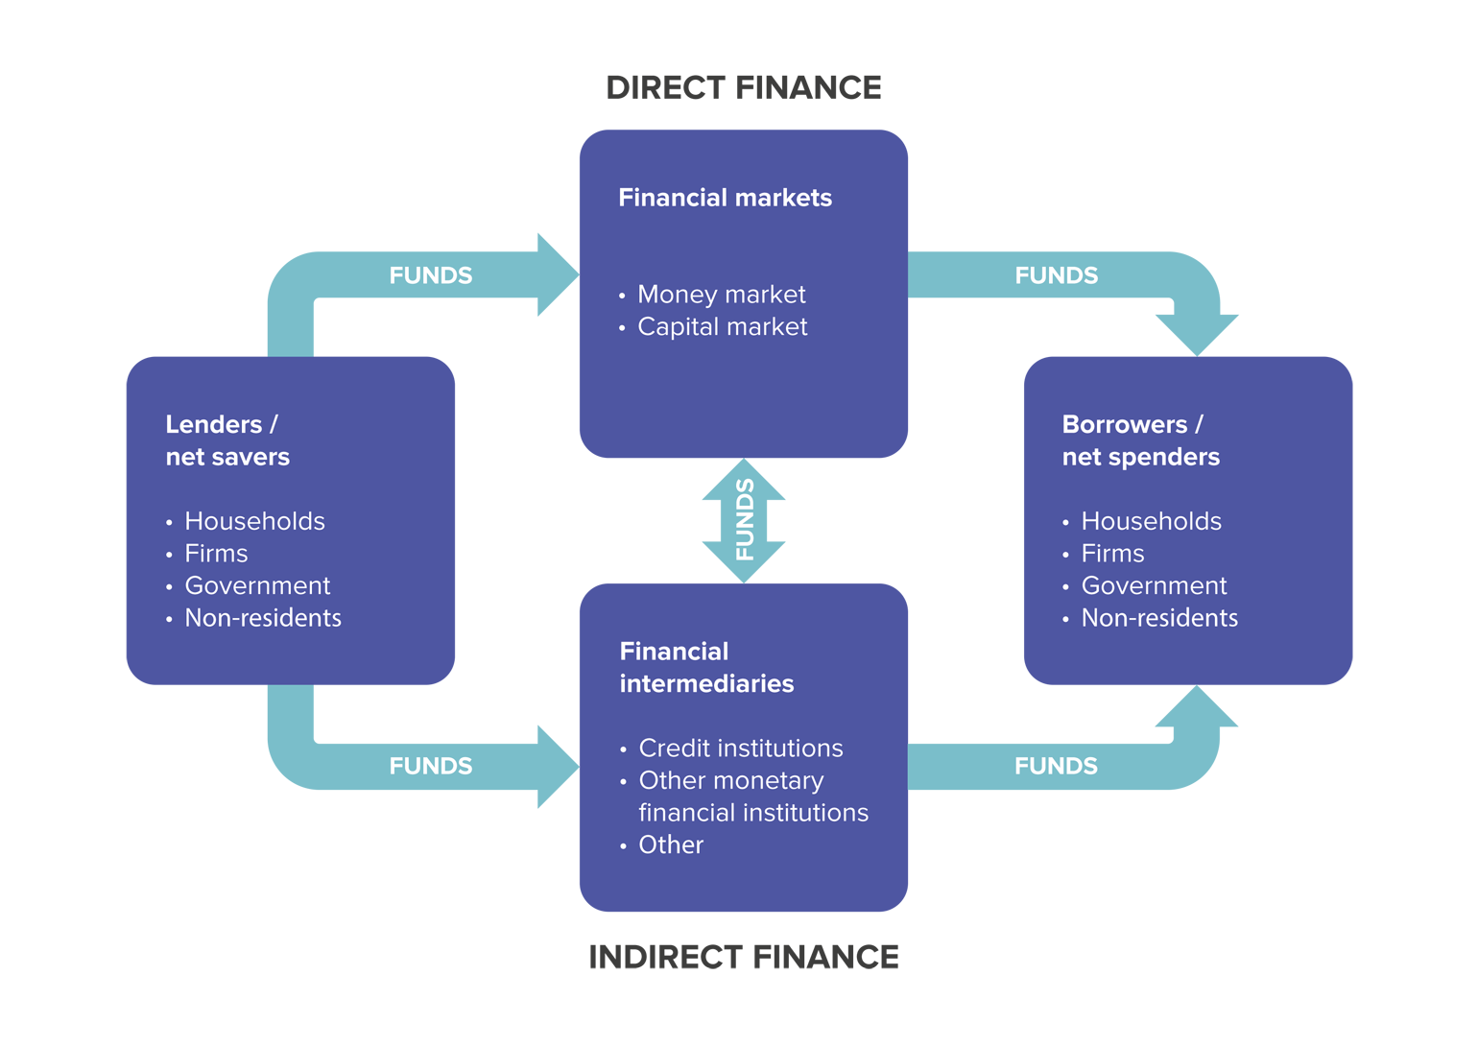
Financial System, Financial Markets and Instruments
Financial System
Financial System
Borrowers
A financial system is the system that enables lenders and borrowers to exchange funds.
Question: why do we need a well-functioning financial system?
Financial Intermediaries
Financial Markets
Financial Intermediaries
Lenders

Slide 7
Financial System, Financial Markets and Instruments
Financial System
The Players
Borrowers: firms, governments, households
Savers: households, governments, firms
Financial intermediaries: the financial institutions which stand between the security issuer and the ultimate owners and bring together lenders and borrowers.
Examples: Commercial banks, investment companies (such as mutual funds), insurance companies, and investment banks.
Notes: Firms raises capital by directly selling securities such as stocks and bonds to the public. Because firms do not do so frequently, investment banks can do this at a lower cost. In this role, they are called _______________.
Notes:
underwriters

Slide 8
Financial System, Financial Markets and Instruments
Asset Classes and Financial Instruments
Money Market (T-bills, CD, CP, BA, ……)
Maturity: Up to 1 year
Debt/Fixed income: T-bonds, Corporate bonds, ……
Capital Market
Maturity: more than 1 year
Equity: Common stocks, Preferred stocks
Question: why do we need so many different kinds of financial instruments?

Slide 9




Financial System, Financial Markets and Instruments
Asset Classes and Financial Instruments
Treasury Bills (T-bills): T-bills are a way for the U.S. government to raise money from the public. They are short-term securities that mature in one year or less from their issue date.
T-bills are issued with maturities of 4, 13, 26, 52 weeks.

Slide 10
Financial System, Financial Markets and Instruments
Asset Classes and Financial Instruments
Time deposit/Fixed deposit/Term deposit/Certificate of deposits (CDs): a savings certificate entitling the bearer to receive interest. A CD bears a maturity date, a specified fixed interest rate and can be issued in any denomination. CDs are generally issued by commercial banks. The term of a CD generally ranges from one month to five years.
CDs offer a slightly higher yield than T-Bills because of the slightly higher default risk for a bank.
Time deposits may not be withdrawn on demand.
Negotible Certificate of deposit (NCD): also known as jumbo CD, NCD is large certificate of deposit that has minimum face value of $100,000 (typically 1 million). NCD can be easily traded in the market.

Slide 11
Financial System, Financial Markets and Instruments
Asset Classes and Financial Instruments
Commercial paper is an unsecured, short-term loan issued by a large, well-known companies.
Typically for financing operations, such as inventories, accounts receivable, and payroll (news).
Maturities range up to 270 days. Most often, commercial paper is issued with maturities of less than 1 or 2 months and is issued with multiple of $100,000 (this rules out lots of investors).
Commercial paper is considered to be a fairly safe asset (news).
Commerical papers outstanding
Market size: about 1 trillion (U.S. stock market size :16 trillion)
Notes:
http://www.temasek.com.sg/investorrelations/temasekeurocommercialpaper
https://prezi.com/xvx9dzh__ply/commercial-paper/
Since CP is an unsecured promissory note, any company issuing the paper must represent a good credit risk. CP issuers are typically household names and have a substantial net worth. CP is not for small companies. Investors must be willing to buy unsecured CP based on the company’s reputation and review of the company’s financial position. Without a very strong reputation, the dealers of CP (“placement agents”) would not be able to successfully sell this product.

Slide 12
Financial System, Financial Markets and Instruments
Asset Classes and Financial Instruments
Bankers' acceptance (BA) is a short-term credit investment created by a non-financial firm and guaranteed by a bank to make payment.
When a bank endorses the order for payment as “accepted,” it assumes responsibility for ultimate payment to the holder of the acceptance. Thus, they are considered as very safe assets.
They are widely used in foreign trade where the creditworthiness of one trader is unknown to the trading partner.
Notes:
Money Market : What is Banker's Acceptance? How it works? Pro & Cons (Download for free) CFA Level 1
https://www.youtube.com/watch?v=mPB_ezqe5iA

Slide 13



Financial System, Financial Markets and Instruments
Asset Classes and Financial Instruments
Treasury Notes (T-notes) and Treasury Bonds (T-bonds):
T-notes are issued with maturities ranging up to 10 years while T-bonds are issued with maturities ranging from 10-30 years.
They typically make semiannual coupon payments.

Slide 14
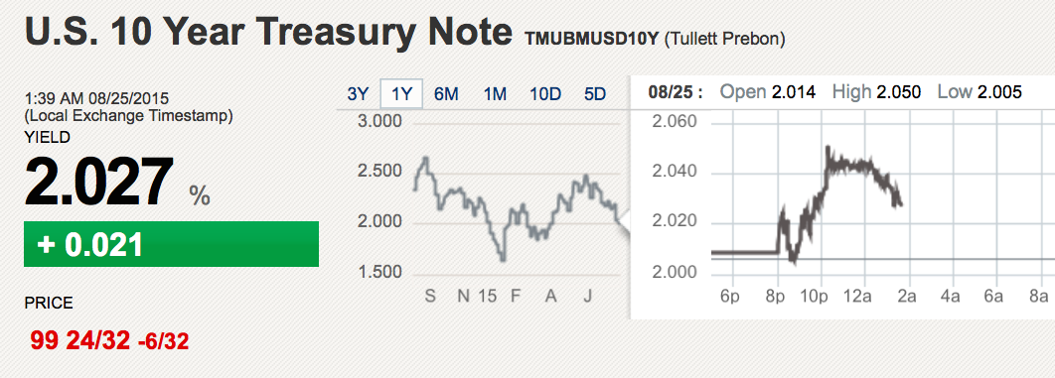


Financial System, Financial Markets and Instruments
Asset Classes and Financial Instruments
Example (Listing of Treasury Bonds and Notes):
Maturity Coupon Bid Asked CHG
May 15 38 4.500 102:29 103:00 -20
Bid: bid price is the price at which the dealer is willing to buy.
Asked: asked price is the price at which the dealer is willing to sell.
102:29=102 29/32 %=102.906% of the face value. For example, if the face value is $1000, then the bid price is $1029.06

Slide 15
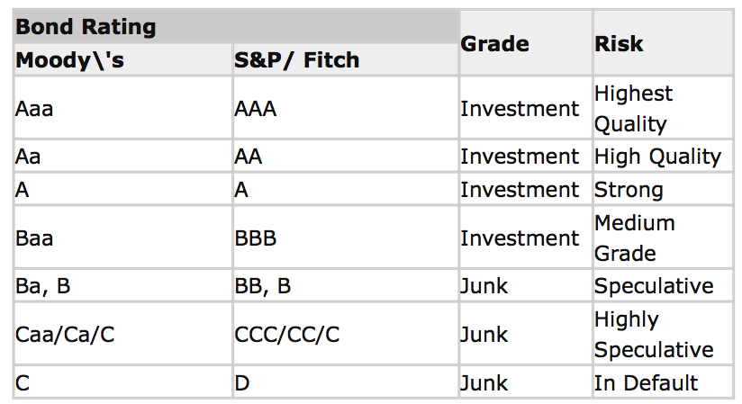
Financial System, Financial Markets and Instruments
Asset Classes and Financial Instruments
Corporate Bonds are the means by which firms borrow money directly from the public.
Similar in structure to T-bonds. They typically pay semiannual coupons over their lives and return the face value to the bondholder at maturity.
Secured bonds vs. debentures (unsecured bonds)
They differ in degree of risk (default risk).
Bond rating on the news
Credit rating agency

Slide 16
Financial System, Financial Markets and Instruments
Asset Classes and Financial Instruments
Common Stock
Also known as equity securities or equities
Represents ownership shares in a corporation. (each share of common stock entitles its owner to one vote.)
The members of the board are elected at the annual meeting. Shareholder who do not attend the meeting can vote by proxy. (Management usually solicits proxies of stockholders and normally gets a vast majority of these proxy votes.)
Residual claim: stockholders are the last in line of all those who have a claim on the assets and income of the corporation.
Limited liability: the most shareholders can lose in the event of failure of the corporation is their original investment. Management will be responsible for the liabilities! (That’s why you often see LLC (limited liability company.)
Stock Market Listing (googlefinance)

Slide 17
Financial System, Financial Markets and Instruments
Asset Classes and Financial Instruments
Preferred Stock
It promises to pay to its holder a fixed amount of income (i.e., dividend) each year.
However, the firm retain discretion to make the dividend payments to the preferred stock holders.
It has no voting power.
Quick Review

Slide 18
Financial System, Financial Markets and Instruments
Asset Classes and Financial Instruments
Stock and Bond Market Indexes (2.4)
Why information do indexes tell you?
Overall performance of the stock/bond/property market
Stock Market Indexes
Price-weighted index: Dow Jones Industrial Average (created in 1896)
Market-value-weighted index: S&P500 (introduced in 1957)
Notes: The Dow Jones Industrial Average (DJIA), also commonly referred to as “the Dow Jones” or simply “the Dow,” is one of the most popular and widely recognized stock market indices. It measures the daily stock market movements of ______ U.S. publicly-traded companies listed on the NASDAQ or the New York Stock Exchange (NYSE). These publicly-owned companies are considered leaders in the US economy. Currently, Dow Jones’ component stocks include __________, ___________, ___________, and so on.
Notes:
https://corporatefinanceinstitute.com/resources/equities/dow-jones-industrial-average-djia/
30; Apple, VISA, Coke Cola, Microsoft, Disney, Nike

Slide 19
Financial System, Financial Markets and Instruments
Asset Classes and Financial Instruments
Example: Suppose there are only two stocks in the market. Construct a stock index.
Stock Initial price Final price Share
X $25 $30 20
Y $100 $90 1

Slide 20
Financial System, Financial Markets and Instruments
Asset Classes and Financial Instruments
Method 1: Price-weighted index
Example: Dow Jones Industrial Average
Index
Initial value (25+100)/2=62.5
Final value (30+90)/2=60
Percentage change -4%
Notes:
Dow Jones’ component stocks include Apple, IBM, Boeing, American Express, McDonald’s, Wal-Mart, and so on.

Slide 21
Financial System, Financial Markets and Instruments
Asset Classes and Financial Instruments
Method 2: Market-value-weighted index
Example: S&P500
Index
Initial value 20*25+100=600 => 100
Final value 20*30+90=690 => 115
Percentage change 15%
600/100=690/x => x=115
Notes:
Price-weighted index gives higher-priced shares more weight in determining performance of the index compared to market-value-weighted index.

Slide 22
Financial System, Financial Markets and Instruments
Asset Classes and Financial Instruments
When stock split happens, price-weighted index may provide “incorrect information” without proper adjustment. (You may want to refer to: what is stock split, Apple’s stock split , CNN)
Stock Split Example: Suppose there are only two stocks in the market. Stock Y has a 1-to-2 stock split.
Stock Initial price Final price Share
X $25 $25 20
Y $100 $50 1=>2
Notes:
Apple split history: 7 for 1 on June 9, 2014; 2-for-1 on Feb 28 2005, June 21, 2000 and June 16, 1987

Slide 23


Financial System, Financial Markets and Instruments
Asset Classes and Financial Instruments
Please calculate the market-value-weighted index
Initial: $25*20+$100*1=600
Final: $25*20+$50*2=600
Please calculate the price-weighted index
(25+100)/2=62.5
(25+50)/2=37.5
25+50/d=62.5 => d=1.2
Unaffected by the stock split

Slide 24




Financial System, Financial Markets and Instruments
Asset Classes and Financial Instruments
Singapore Stock Exchange
Straits Times Index (STI) is a market-value-weighted index.
It tracks the performance of the top _____ companies listed on Singapore Exchange. (including Singtel, DBS, OCBC, UOB, Singapore Airlines, Thai Beverage, …)
Notes:
Answer: 1. MV-weighted index; 2. top 30 companies

